Slide 1
CS100 Roadmap Project
By: Moiez Qamar

Slide 2
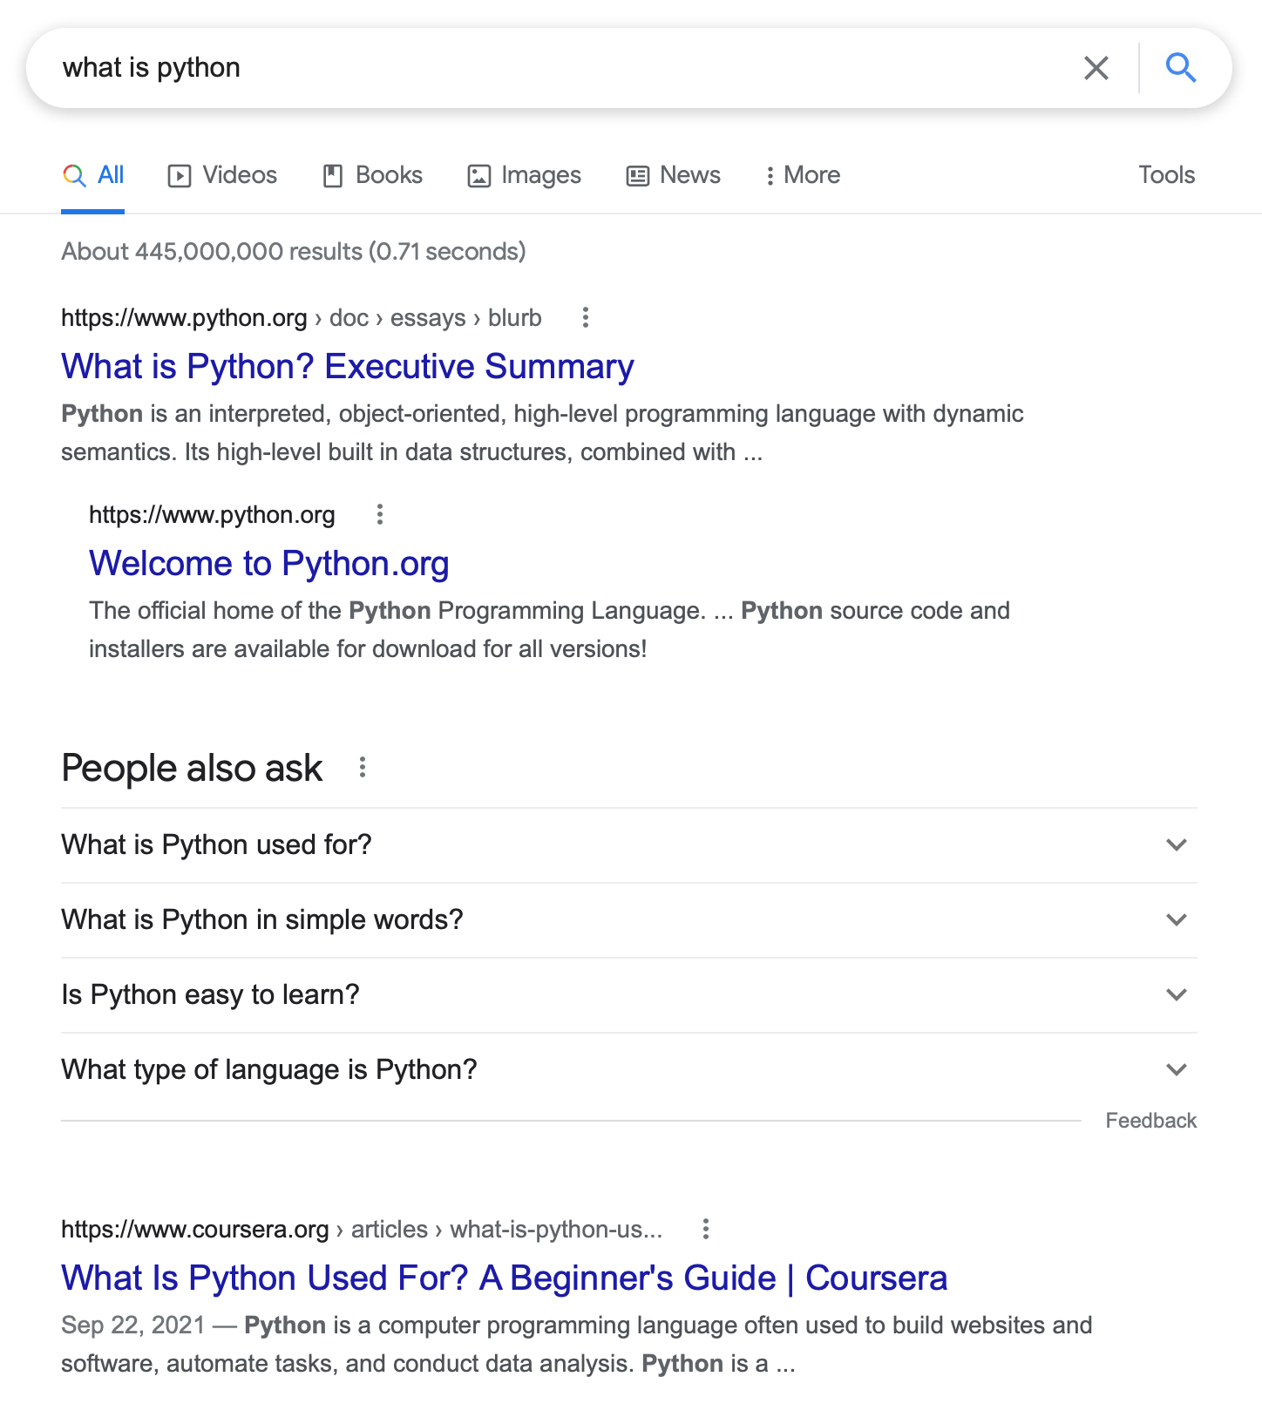
Google PageRank

Slide 3
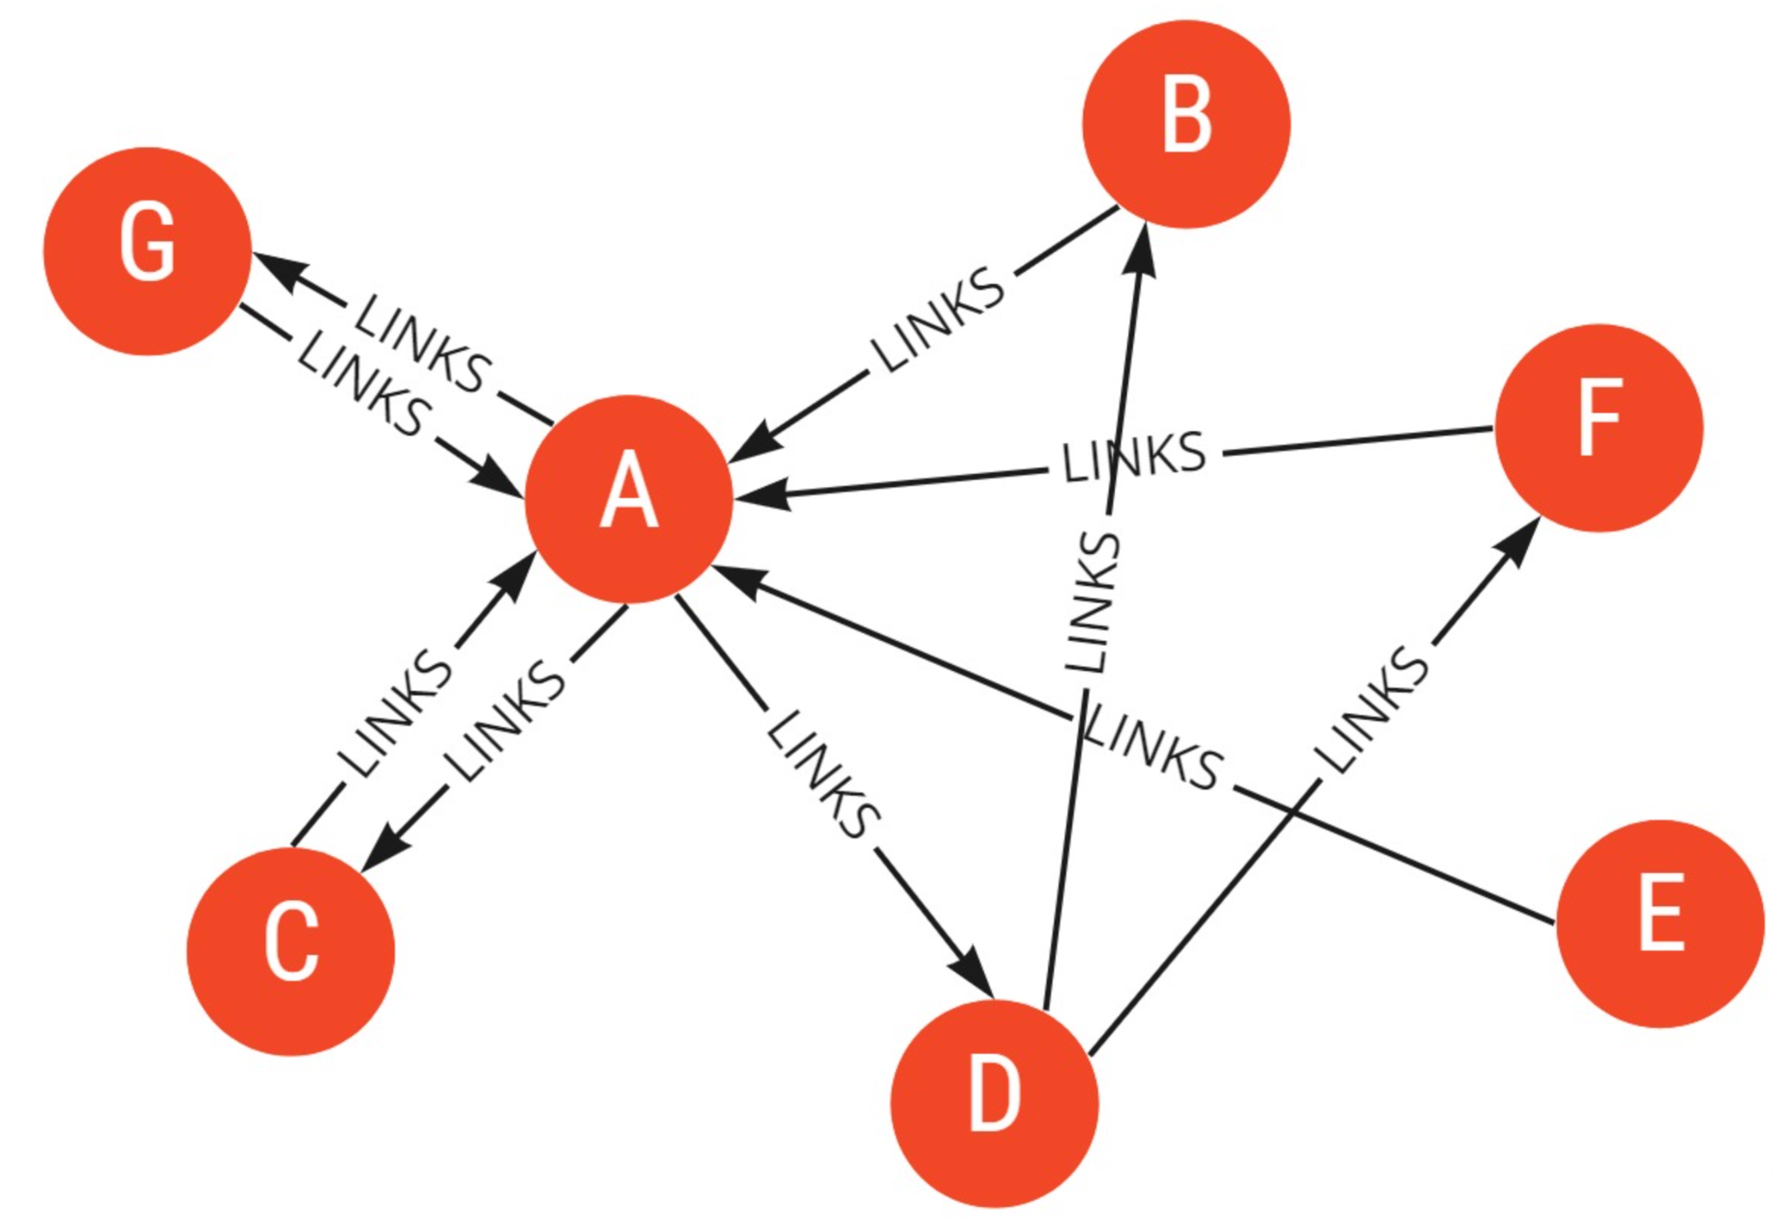
PageRank Algorithm

Slide 4
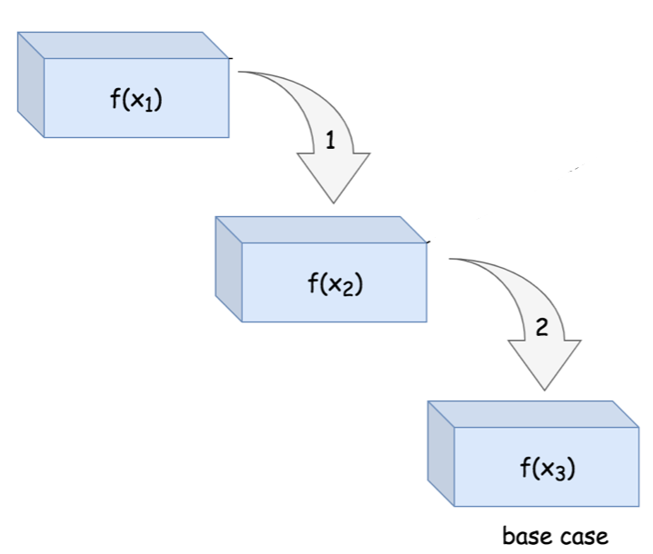
PageRank Mathematically
PR(A) = (1-d) + d (PR(T1)/C(T1) +
... + PR(Tn)/C(Tn))
continues until it finds the base value
Recursion:

Slide 5
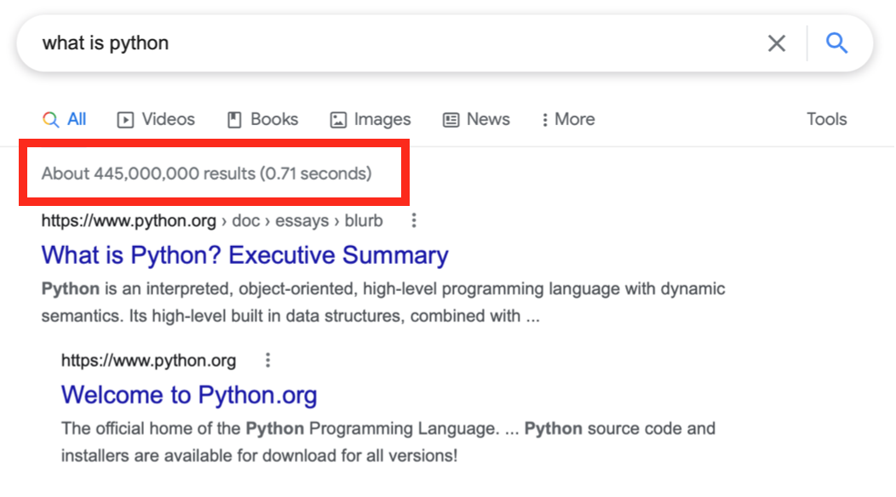
PageRank Complexity
O(k * N)
k = no. of iterations

Slide 6
Thanks,
Any questions?

